Slide 1
Ant Based Survivable Routing
in
WDM Networks

Slide 2
Problem Statement:
Ant colony optimization (ACO) : In this work generate backup paths using basic scheduling and routing mechanisms. In addition to this, the backup paths created by these mechanisms are static paths, which are unaware of impairments in links.
Our proposed approach consists of three phases:
Ant based lightpath setup,
Primary and Backup path computation.
Wavelength allocation

Slide 3
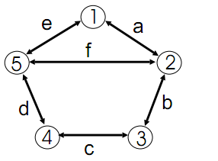
Ant Based lightpath Setup:-
Each path in the network is assigned by feasibility value. This feasibility value is calculated by considering the metrics such as bandwidth availability, path length and number of free wavelengths.
logical topology

Slide 4
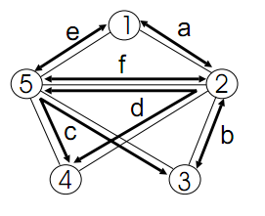
survivable routing
On completing the updation of pheromone table, the ant updates load of that particular path in the load table. The value of path load is dynamically updated by the ant in the load table.

Slide 5
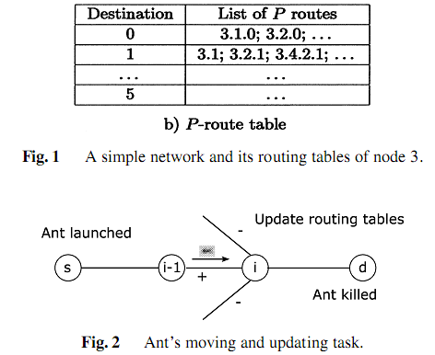
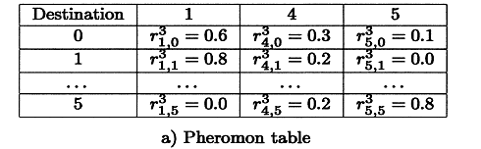

Slide 6
Primary and Backup Path Computation
Initially, in the path, a major part of the bandwidth is allocated for primary path and this part can not be shared by other paths. Fraction of the bandwidth is allocated for backup path and this can be shared by other disjoint paths. The disjoint path can be primary or backup path. The residual bandwidth is used for future primary and backup paths computations.
The backup path can be triggered in two scenarios.
Failure Detection
Congestion Detection

Slide 7
Failure Detection:
When any intermediate node detects node failure or fiber failure, then it sends FAILURE warning message to the source node along the alternate light path.
Congestion Detection
If the load value exceeds beyond Th_{LOAD}, then it will lead the network to congestion and consequently to the blocking of services. Thus, to prevent these, we let the intermediate node to send a CONGESTION warning message to the source before it exceeds Th_{LOAD.}

Slide 8
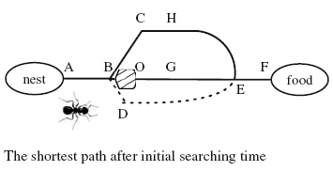

Slide 9
Wavelength Allocation
The typical constraints for wavelength allocation problem are the limited wavelength number on each link and the wavelength continuity constraint for all WDM networks.
The interconnected multilayer-graph model (IMG) [22] is used for the wavelength allocation. We consider that part of the nodes have wavelength conversion. For nodes without wavelength conversion capability, the wavelength continuity constraint is checked while establishing the light paths .
The wavelength assignment algorithm assigns wavelengths to the primary and backup paths in order to share the resources between the current traffic requests and the already established requests.

Slide 10
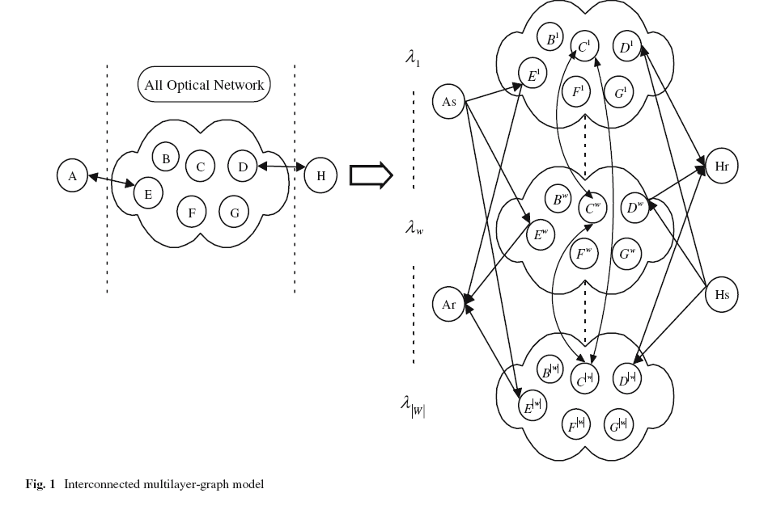

Slide 11
Procedure:-
Step 1. An ant is launched in the network by each node periodically towards the destination.
Step 2. When an ant is launched in the network by its node, it moves towards random destination to gather information such as bandwidth availability, path length and free wavelengths in that path.
Step 3. After gathering the information it updates pheromone table, which is feasibility value of corresponding path.
Step 4. Each path in the network is assigned the feasibility value.

Slide 12
Step 5: On completing the updation of pheromone table, the ant updates load of that particular path in the load table. The value of path load is dynamically updated by the ant in the load table.
Step 6: In the path, a major part of the bandwidth is allocated for primary path and this part can not be shared by other paths.
Step 7: Fraction of the bandwidth is allocated for backup path and this can be shared by other disjoint paths. The disjoint path can be primary or backup path. The residual bandwidth is used for future primary and backup paths computations.

Slide 13
Step 8: If connection request arrives to the source, then
8.1 It looks in its pheromone and load table
8.2 send connection request (CNREQ) message to the destination along with feasibility and load values of paths.
Step 9: If destination receives the CNREQ, then
9.1 If feasibility value > Th_{feas} and load value < Th_{LOAD,} then
9.1.1 Select that path for further processing.

Slide 14
Results:-
Using NS-2 simulation we show that the proposed ant based routing achives better channel utilization and throughput with reduced delay, when compared with the normal routing. We measure performance metrics delay, throughput and bandwidth utilization, by varying the CBR traffic sending rate and flows.

Slide 15
Future Scope:-
The Routing and Wavelength path network that has higher feasibility value and the load value lesser than a threshold value can be selected by the destination for further processing.
As a future work, an accurate fault localization technique for the WDM network can be designed.

Slide 16
Conclusion
In this work, we have proposed an ant based approach for survivable routing in WDM networks. An ant is launched in the network by each node periodically towards the destination. Each path in the network is assigned by feasibility value.
When an ant is launched in the network by its node, it moves towards random destination to gather information such as bandwidth availability, path length and free wavelengths in that path. After gathering the information it updates pheromone table, which is feasibility value of corresponding path. On completing the updation of pheromone table, the ant updates load of that particular path in the load table. The value of path load is dynamically updated by the ant in the load table. The path that has higher feasibility value and the load value lesser than a threshold value can be selected by the destination for further processing.

